Slide 1
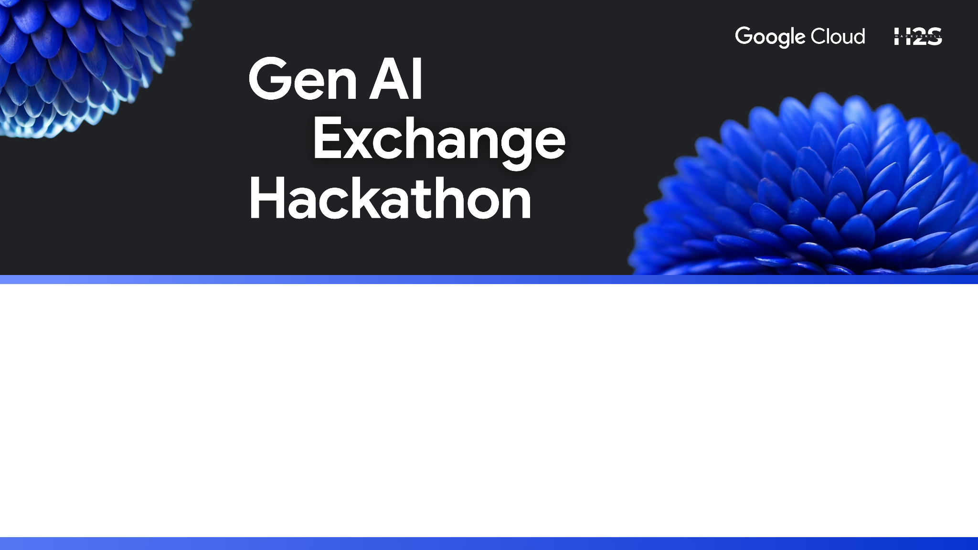
Team Name : ChronoCoders
Team Leader Name : Shivam Yadav
Problem Statement : Generative AI For Youth Mental Wellness

Slide 2
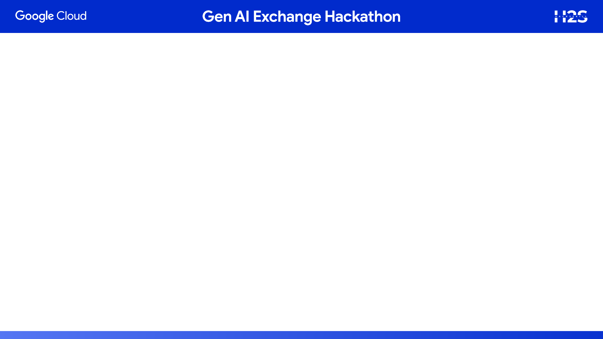
Our Solution: The Prototype
Generative AI Core: Utilizes generative AI to deliver personalized and empathetic responses, making the user feel heard and understood.
Accessible Support: Designed to provide immediate, 24/7 access to mental wellness support, overcoming barriers of cost and location.
Culturally Sensitive Resources: Offers tailored guidance and connects users to relevant mental health information and vetted resources within a culturally appropriate framework.
Confidentiality & Empathy: A secure and non-judgmental AI-powered chatbot that provides a safe space for confidential conversations.
Purpose: Aims to destigmatize mental health discussions and empower Indian youth to seek the help they need.

Slide 3
Opportunity
How is it different? Our solution offers a scalable, empathetic, and confidential AI that provides real-time, personalized support, unlike traditional solutions that are expensive, inaccessible, or non-dynamic.
How will it solve the problem? It addresses the core issues of stigma and limited access by providing a safe, private space for dialogue, acting as a crucial first step toward help, and intelligently bridging the gap to professional care.
USP: The unique selling point is empathetic accessibility. We combine a scalable AI with a confidential, non-judgmental interface to offer universally available support that feels personal and genuine.

Slide 4
Key Features
Confidential Chat Interface: A secure, private space where users can interact with the AI without any fear of their identity or data being compromised.
Empathetic AI Companion: The core feature is a chatbot powered by generative AI that understands and responds to emotions, making conversations feel natural and supportive.
Personalized Guidance: Offers tailored coping strategies, journal prompts, and guided exercises based on the user's input and mood.
Resource Finder: Intelligently connects users to verified, culturally sensitive mental health resources and professionals in their local area when they need human intervention.
On-Demand Content Generation: The AI can create new content like guided meditations, breathing exercises, or calming stories on the spot, addressing the user's immediate needs.

Slide 5
Process flow diagram
3. AI-Powered Interaction ➡️ Generative AI Chat Assistant
Empathetic conversation
Natural language understanding
Provides confidential support
Onboarding
➡️ Anonymous Login / Confidential Mode ➡️ Basic check-in (mood scale, stress level, short survey)
Core Features
📘 Self-Help Resources
🎯 Personalized Guidance
🧠 AI Well-Being Companion
📊 Mood Tracking Dashboard
Start
User Entry Point
➡️Youth accesses the platform
Escalation Mechanism ➡️ If high distress detected →
Suggest professional helplines
Connect to affordable therapists / NGOs
Provide emergency contacts
Continuous Learning (Backend) ➡️ Google Cloud Generative AI + NLP → Improves recommendations ➡️ Feedback loop → More culturally sensitive + empathetic over time
Community & Stigma Reduction ➡️ Peer stories (anonymized) ➡️ Safe forums moderated by AI (to reduce bullying/shaming) ➡️ Campaigns to normalize mental health talk
End

Slide 6
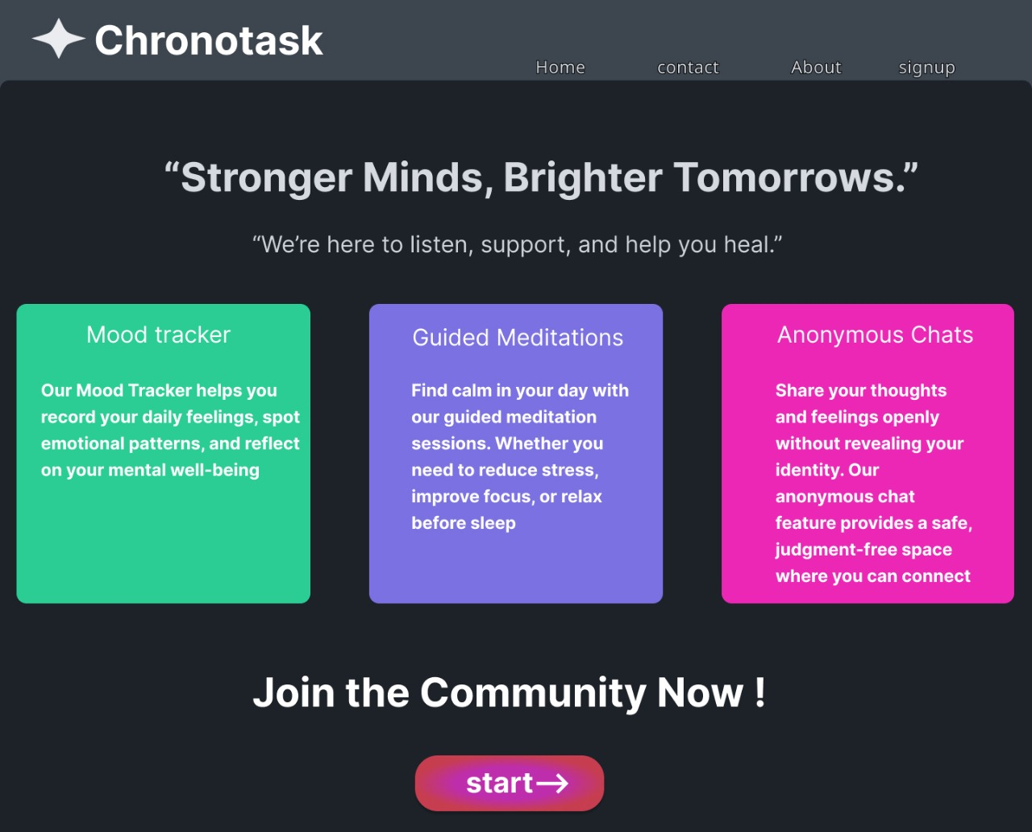
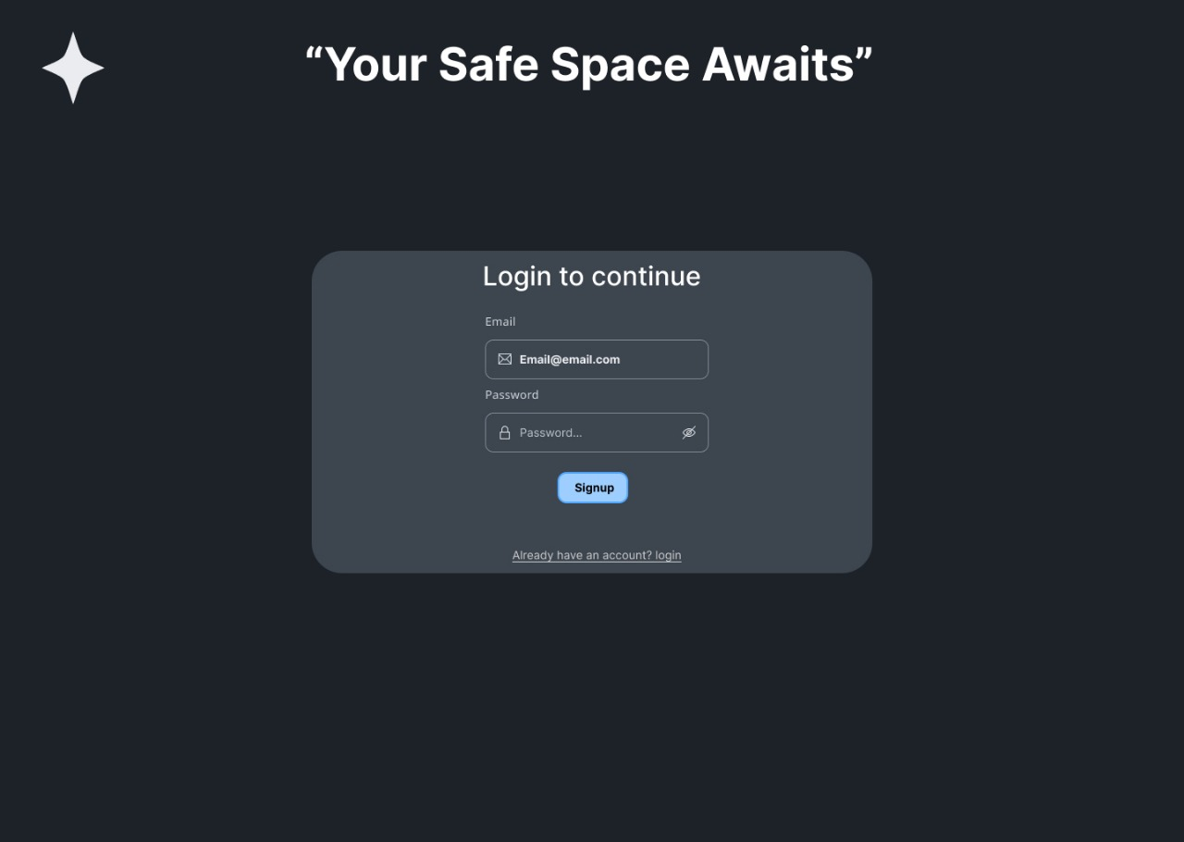
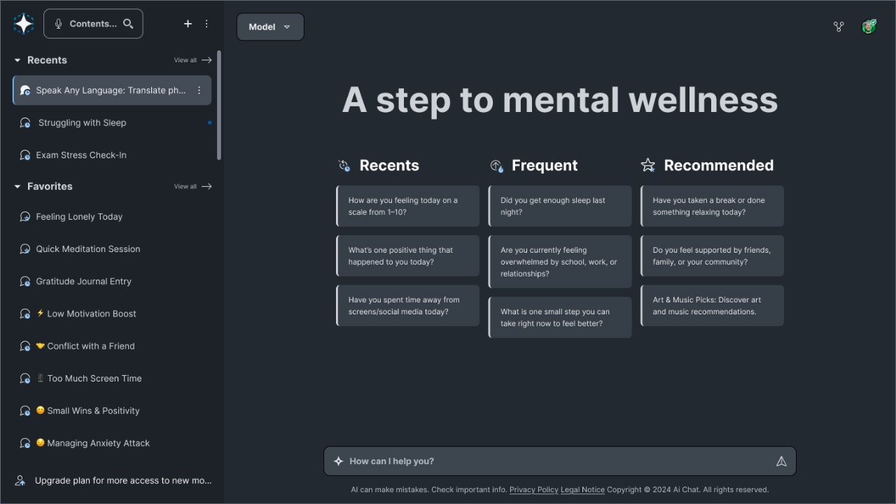
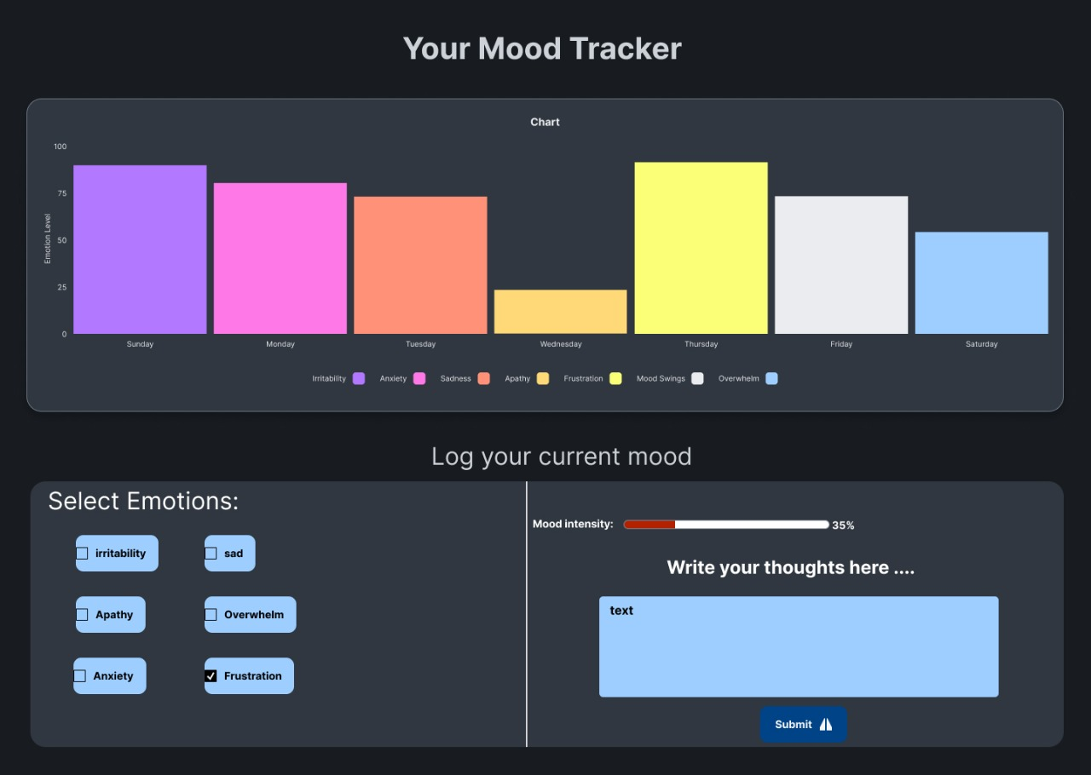
Wireframes/Mock diagrams of the proposed solution
Landing
page
Login page
Chatbot
for mental issues
Mood
Tracker

Slide 7
Architecture diagram of the proposed solution
Processes requests and business logic
Generative chatbot and recommendations
Where users interact with our solution
User interface for interaction
User Mobile/App
Frontend
-> Chat interface
-> Dashboard
Backend server
-> API Gateway
-> Authentication
-> Logic
AI/ML
-> Chatbot
-> NLP
-> Recommendation
Stores profiles, chats, resources
monitoring, improvement
Protects data with authentication
Integrates helplines and cloud services
Analytics
-> Insights
->Feedback logic
Security Layer
Data encryption, user authentication, role-based access
External Services
-> Helplines
-> Cloud APIs
Database
-> Profiles
-> History
-> Resources

Slide 8
Technologies Used:
Frontend:
React & Tailwind CSS: For a responsive, visually appealing, and user-friendly chat interface.
Backend & Cloud:
Google Cloud Functions: For a scalable, serverless backend.
Fire-store: For secure, scalable, non-identifiable data storage.
Core AI:
Vertex AI: The platform for managing and running the AI model.
Google Cloud's Gemini API: The generative AI model that powers the empathetic conversation.
Security:
Firebase Authentication: For secure, private, and anonymous user sessions.

Slide 9


